Slide 1
Continuous Heart Rate and Body Temperature Monitoring System using Arduino UNO and Android Device
2nd International Conference on EICT, KUET
December 10-12, 2015
Presented by
Md. Siddiqur Rahman Tanveer
Co-Authors: Md. Asaduzzaman Miah, Mir Hussain Kabir and M. A. H. Akhand
Department of Computer Science Engineering
Khulna University of Engineering & Technology (KUET)

Slide 2
OUTLINE
Motivation
Objectives
Proposed System diagram
Functional block diagram
Heart beat sensing mechanism
Body temperature sensing
Implemented system
Experimental results
references

Slide 3
Motivation
Heart rate indicates the soundness of our heart
Heart rate helps assessing the condition of cardiovascular system
It is not possible for a doctor to observe a patient’s heart rate per minute and body temperature all the time
Again a doctor far way from the patient need to know heartrate and body temperature for initial treatment
An embedded system which can measure the heart rate and body temperature and store the data for the doctor to know the condition of the patient can help for this purpose

Slide 4

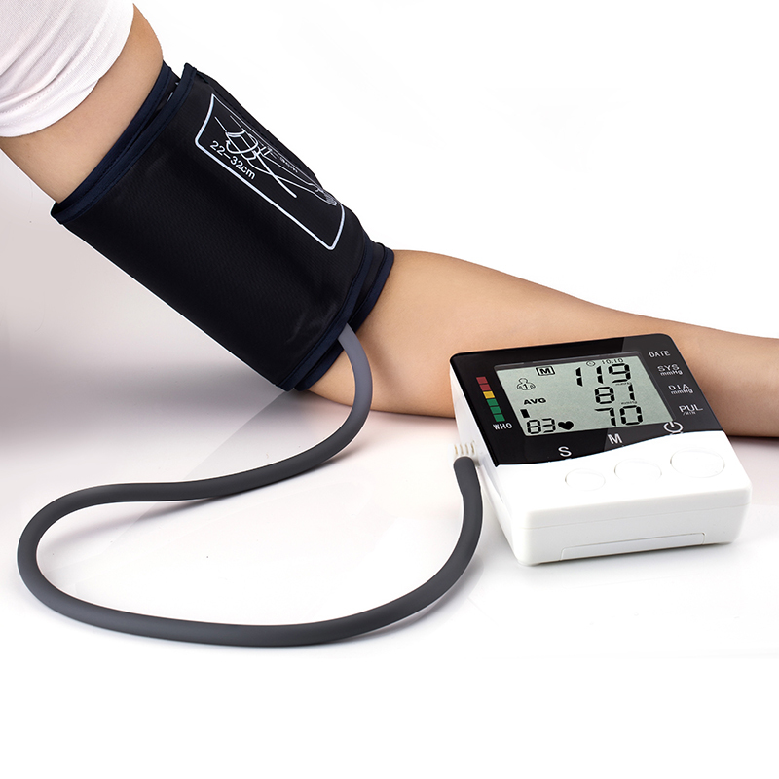
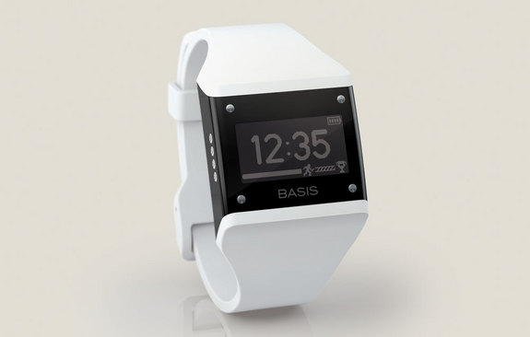
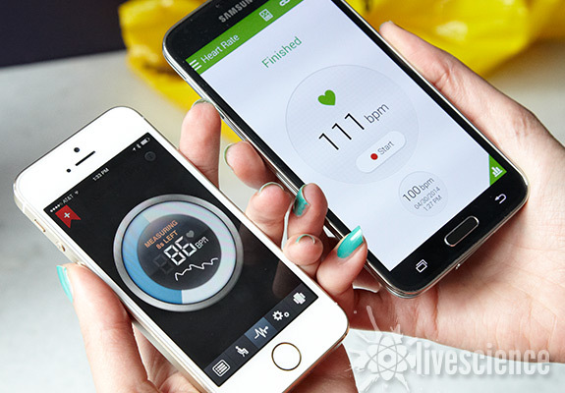
Existing Systems
Electronic
sphygmomanometer
Manual System
Basis B1
Smart Phone (Android & iOS)

Slide 5
Objectives
The major objectives of our developed system are listed below:
To measure heart rate
To measure body temperature
Continuously display the result in Android device
To observe the patient’s health condition continuously

Slide 6
Proposed System Diagram

Slide 7

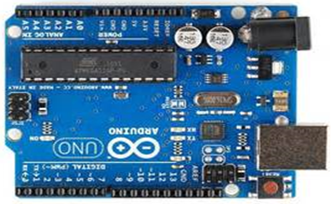
System Development Tool
Arduino Programming
1. arduino-1.0.5-r2-windows (IDE)
2. C++
Android Programming
1. Eclipse v21.0.1-543035 (ADT)
2. Java

Slide 8
Functional Block Diagram

Slide 9
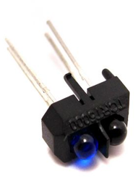
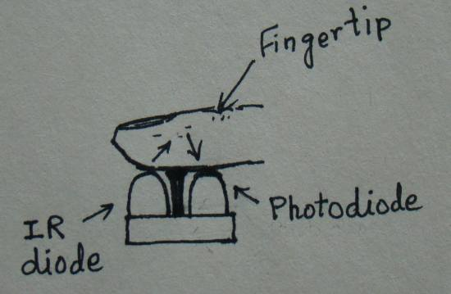
TCRT5000 Optical Sensor For
Heart Beat Sensing Mechanism
The sensor used in this system is TCRT5000 which is a reflective optical sensor. It consists of an infrared LED that transmits an IR signal through the fingertip of the subject, a part of which is reflected by the blood cells. The reflected signal is detected by a photo diode sensor. By sensing the change in blood volume in a finger artery while the heart is pumping the blood.

Slide 10
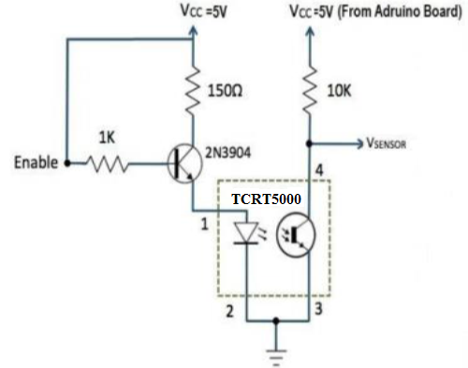
Heart Beat Sensing Mechanism
STEP1: Pulse Detection
STEP2: First Stage Signal Conditioning

Slide 11
Heart Beat Sensing Mechanism (Cont..)
STEP3: Second Stage Signal Conditioning

Slide 12
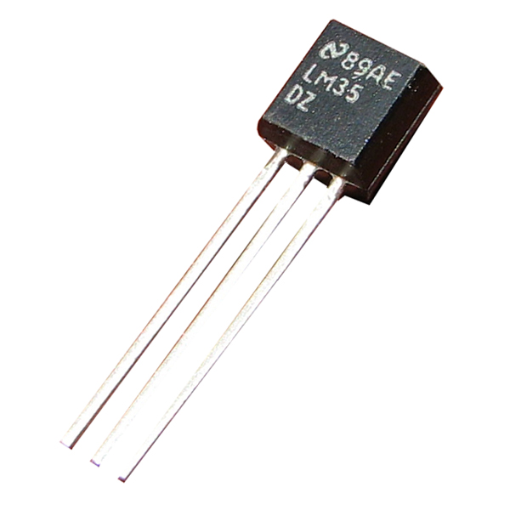
Body Temperature Sensing Using LM35 Temperature Sensor
Features
Calibrated Directly in Celsius (Centigrade)
Linear + 10-mV/°C Scale Factor
0.5°C Ensured Accuracy (at 25°C)
Rated for Full −55°C to 150°C Range
Suitable for Remote Applications

Slide 13
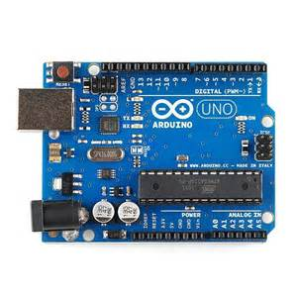
Arduino UNO
The Uno is a microcontroller board based on the ATmega328P which is our main processing unit of the system
Technical specification
Microcontroller | ATmega328P
Digital I/O Pins | 14 (among 6 provide PWM output)
Flash Memory | 32 KB (ATmega328P)
SRAM | 2 KB (ATmega328P)
EEPROM | 1 KB (ATmega328P)
Clock Speed | 16 MHz

Slide 14
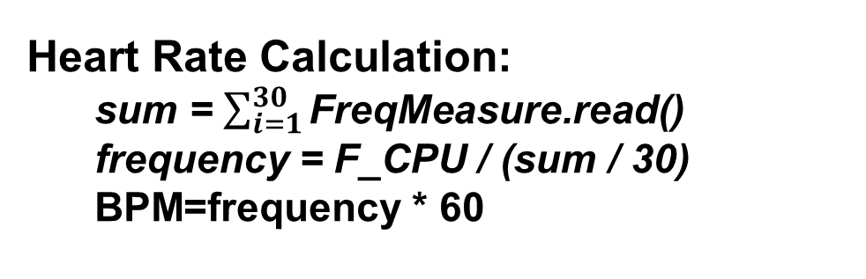
Processing Data Through Arduino UNO
Heart Rate Calculation:
sum = $\sum_{i=1}^{30}{\text{FreqMeasure}\text{.}\text{read}\text{()}}$
frequency = F_CPU / (sum / 30)
BPM=frequency * 60
Body Temperature Calculation
Voltage to Temperature conversion:
Temperature in degree Celsius,
Temp = Output voltage * 0.48828125
Celsius degree to Fahrenheit degree conversion :
tempf=(Temp*1.8)+32

Slide 15
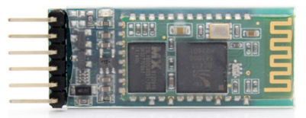
Transferring Arduino UNO Processed Data to Android Device via Bluetooth
The HC-05 module communicates with the Arduino via a serial connection and transfers data to the connected Android device.
HC-05 Bluetooth Module

Slide 16
Implemented System

Slide 17
Heartmate Android Application
This is the simple Android application:
Runs on Android API 17 and more
Shows heart beat rate
Shows body temperature

Slide 18
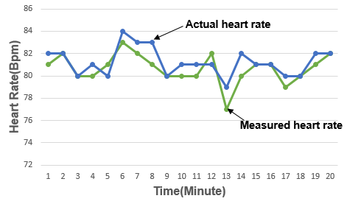
Experimental Results
Figure 1. Actual vs. Measured Heart rate measured for 20 minutes

Slide 19
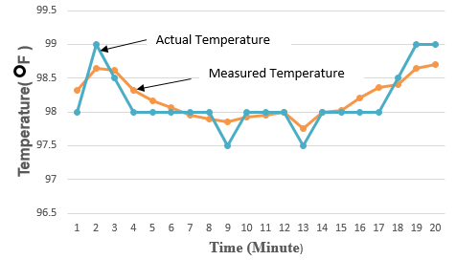
Experimental Results (Cont..)
Figure 2. Actual vs. Measured Body Temperature for 20 minutes

Slide 20
Future Work
Store patient’s heart rate and body temperature in Android device provided SQLite Database system
Implement continuous patient health care monitoring system through centralized server in medical
Implement the system at low cost
Implement remote health monitoring system through “Internet of things (IoT)”

Slide 21
References
[1] M. M. A. Hashem, R. Shams, Md. A. Kader and A. Sayed, “Design and development of a heart rate measuring device using fingertip,” 3rd IEEE International Conference on Computer and Communication Engineering (ICCCE'10), Kuala Lumpur, Malaysia, May 11-12, 2010.
[2] R. G. Landaeta, O. Casas, and R.P. Areny, “Heart rate detection from plantar bioimpedance measurements”, 28th IEEE EMBS Annual International Conference, USA, 2006, pp. 5113-5116.
[3] M. Navale, S. Damare, R. Chavan, R. Dube, and S. Patil “Android Based Heart Monitoring and Reporting System”, International Journal of Advanced Research in Computer and Communication Engineering Vol. 3, Issue5, May 2014
[4] N. Indumathy and K. K. Patil “Medical Alert System for Remote Health Monitoring Using Sensors and Cloud Computing” International Journal of Research in Engineering and Technology, vol. 3, no. 04, pp. 884-888, 2014.

Slide 22
THANK YOU

